Slide 1
HTML TAGS
MCNDHS
Ms. Eng

Slide 2
AIM: HOW DO WE CREATE A WEBPAGE ON A PC?
Do now:
Grab a laptop.
Open Google Chrome
Daily Grade:
On-time/attendance/not leaving the classroom: 25%
Cellphones: 25%
Notes:25%
Classwork/Homework: 25%

Slide 3
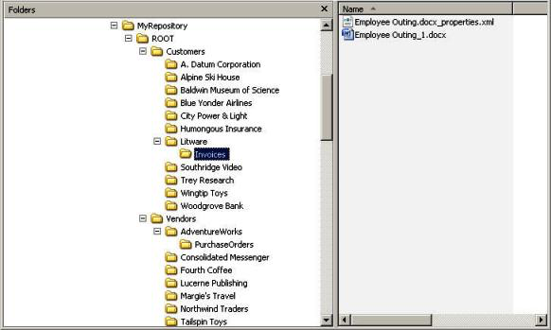
STARTING OUT…
You must create a RESPOSITORY that stores all your files, images, videos, media… etc that you plan to use for your webpage.

Slide 4
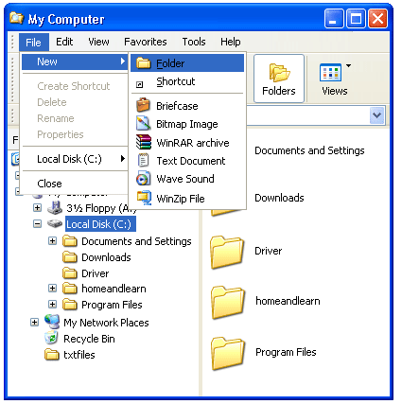
CREATING YOUR REPOSITORY
Step 1:
go to MY COMPUTER
Step 2: Click File < New< Folder

Slide 5
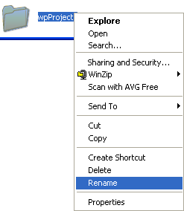
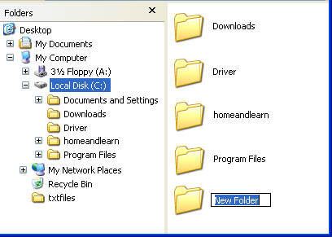
NAMING THE FOLDER
Right click on your folder and click RENAME

Slide 6
WHAT IS THIS FOLDER YOU JUST CREATED?
This is the ROOT FOLDER of your project.
The embodiment(collection) of all the folders that will be inside the root folder is the REPOSITORY.

Slide 7
ACTIVITY
Create the following folders within your repository:
images
aboutme
contact
media
** General rules for naming folders:
NO SPACES
NO SYMBOLS ex: !@#%$^*^&_+
KEEP EVERYTHING LOWERCASE
Raise your hand if you need assistance!

Slide 8
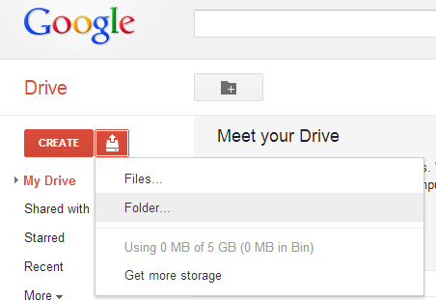
SAVING YOUR REPOSITORY TO GOOGLE CHROME

